Slide 1

Marketing Campaign Analysis
ENT 2017: AI and Data Analytics
Group 8:
Adarsh Tiwari, Isha, Kushal Shahi, Laldinpuia Hmar, Shruti

Slide 2

Introduction
The purpose of this analysis is to evaluate the effectiveness of the recent marketing campaigns. By examining customer demographics, spending behaviors, and responses to promotions, we aim to uncover insights that will inform future campaign strategies and maximize ROI.

Slide 3




Objectives & Goals
Understand customer demographics and their influence on purchasing behavior.
Assess the effectiveness of promotional campaigns and customer responses.
Identify key product preferences and customer segments.
Provide recommendations for optimizing future marketing strategies.

Slide 4
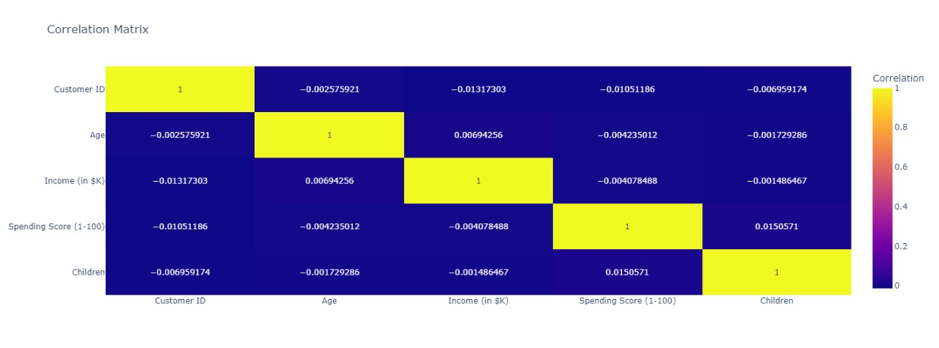
Correlation Matrix
The correlation matrix shows weak or negligible relationships between all variables, indicating they are largely independent of each other. Spending score has a very slight negative correlation with age and income, while the number of children has a minimal positive impact on spending. Overall, none of the variables influence one another.

Slide 5
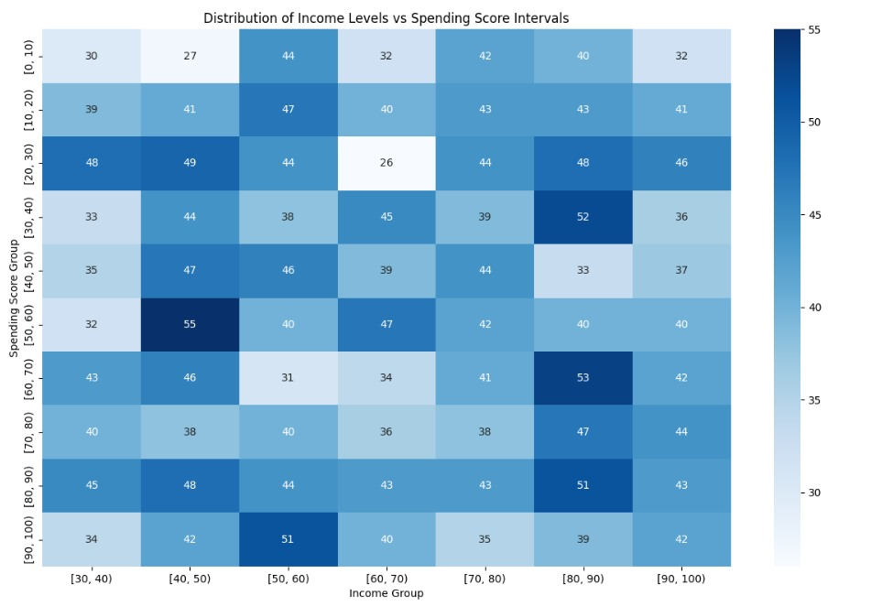
Distribution of income levels VS spending score intervals

Slide 6
Highest Spending Score: The highest value is 55, which occurs for the income group $40,000 - $50,000 in the spending score group 50-60. This suggests that individuals within this income range are likely to spend more, making it a prime target for higher-end products.
Lowest Spending Score: The lowest value is 26, found in the $60,000 - $70,000 income group within the 20-30 spending score range. People in this income group are more conservative with their spending, indicating that low-end product offerings may appeal more to them here.

Slide 7

Product Preferences by income group

Slide 8
Highest Product Preference: The category Cosmetics shows the highest preference with a value of 141 for the income group $40,000 - $50,000. This group seems highly inclined toward purchasing cosmetics, making this category a lucrative area for targeted promotions.
Lowest Product Preference: The lowest product preference is in Home Appliances for the income group $60,000 - $70,000, with a value of 85. This suggests that people in this income bracket are less interested in purchasing home appliances, so marketing efforts for such products may be less effective.

Slide 9
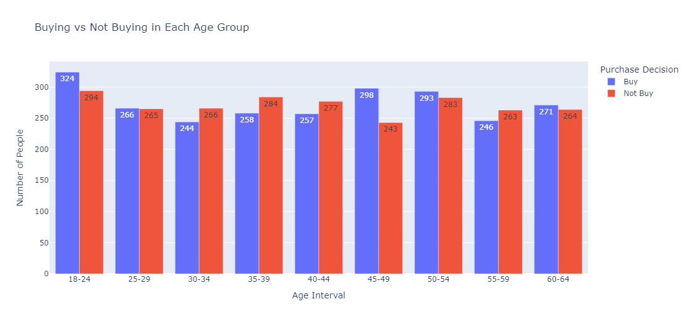
Age VS propensity to buy or to not buy

Slide 10
Prioritize
Young Adults (18-24) Highest Buyers (324): Most receptive to purchasing. Action: Prioritize campaigns targeting this group with relevant offers and digital engagement.
Address
Older Adults (50-54) Highest Non-Buyers (283): Least likely to purchase. Action: Address their concerns or shift resources to more responsive demographics.
Explore
Mid-Age Adults (30-34) Lowest Buyers (244): Engagement is low. Action: Explore new product positioning or targeted promotions for this group.
Offer
45-49 Age Group Opportunity Fewest Non-Buyers (243): Neutral or slightly inclined to purchase. Action: Offer personalized deals to convert this group into loyal buyers.

Slide 11
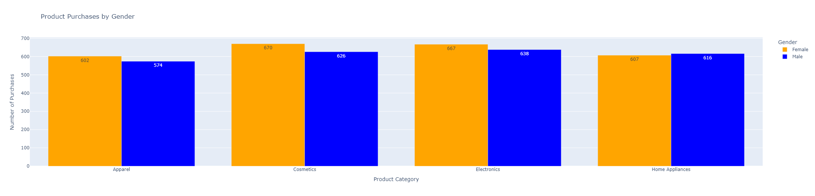

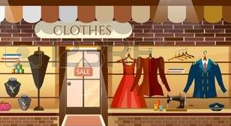

Product Preferences by gender

Slide 12
Female Preferences:
Most Popular: Electronics (667)
Electronics are the top choice for female buyers, highlighting a strong interest in tech products.
Least Popular: Apparel (602)
Apparel is the least preferred product category among females.
Male Preferences:
Most Popular: Cosmetics (670) Surprisingly, cosmetics are the top-selling category for male buyers, indicating growing interest in grooming products.
Least Popular: Apparel (574)
Apparel is the least purchased category among males.
Overall Insights:
Cosmetics and Electronics dominate as the most popular products across both genders.
Apparel is the least purchased category for both male and female customers, suggesting potential for re-strategizing marketing or product offerings in this segment.

Slide 13
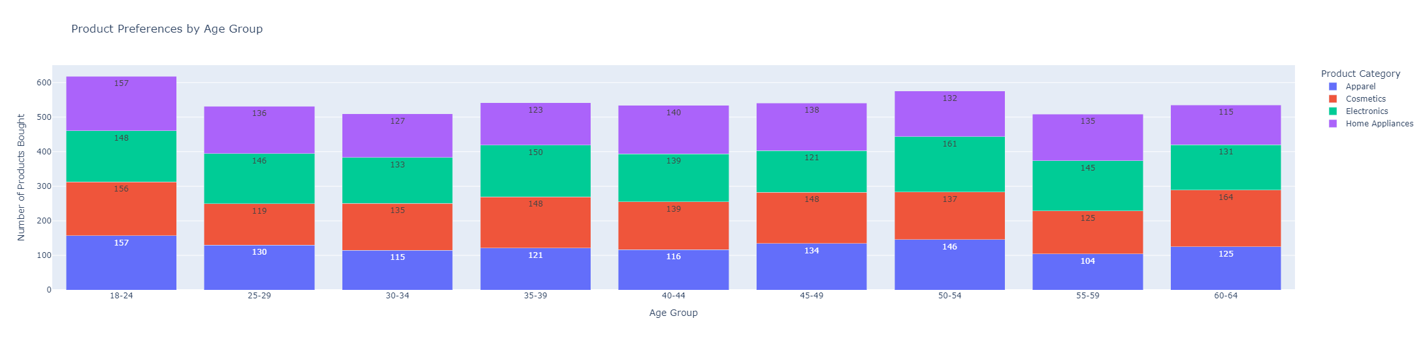
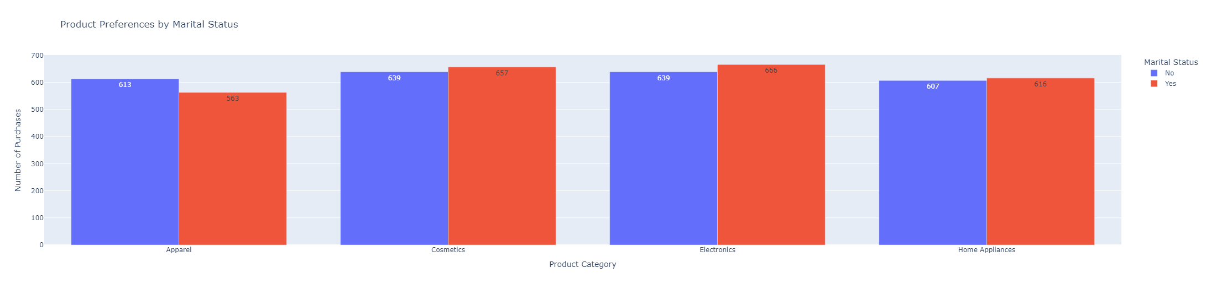
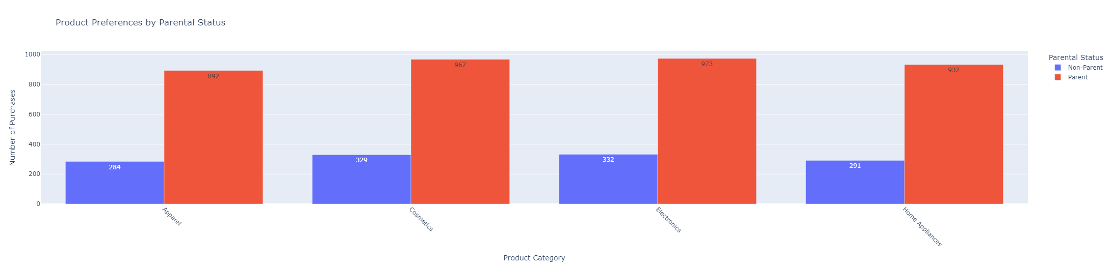
Product Preferences by age, marital and parental status

Slide 14
Age group
In younger age groups (18-34), Apparel and Cosmetics dominate, especially between ages 18-24, while older age groups (50+) show a growing interest in Home Appliances and Electronics.
Marital Status
Married consumers tend to prefer Cosmetics, Electronics, and Home Appliances, with a noticeable preference in Cosmetics (657 vs. 639 for unmarried). Targeting married individuals with promotional campaigns in these categories could yield better results.
Parental Status
Parents show a significantly higher preference for all product categories (Apparel, Cosmetics, Beverages, Home Appliances) compared to non-parents, with a noticeable gap in categories like Cosmetics and Beverages.

Slide 15
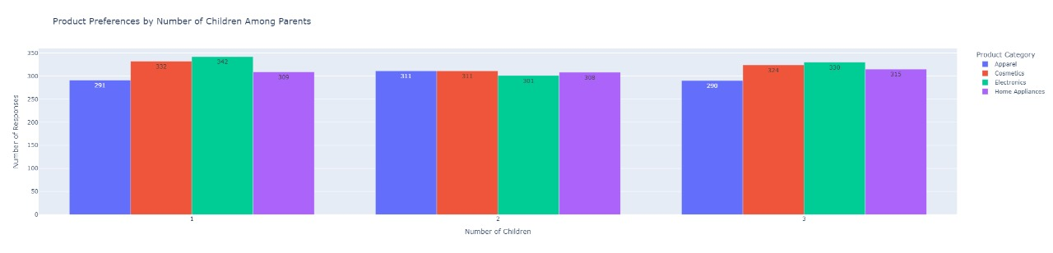
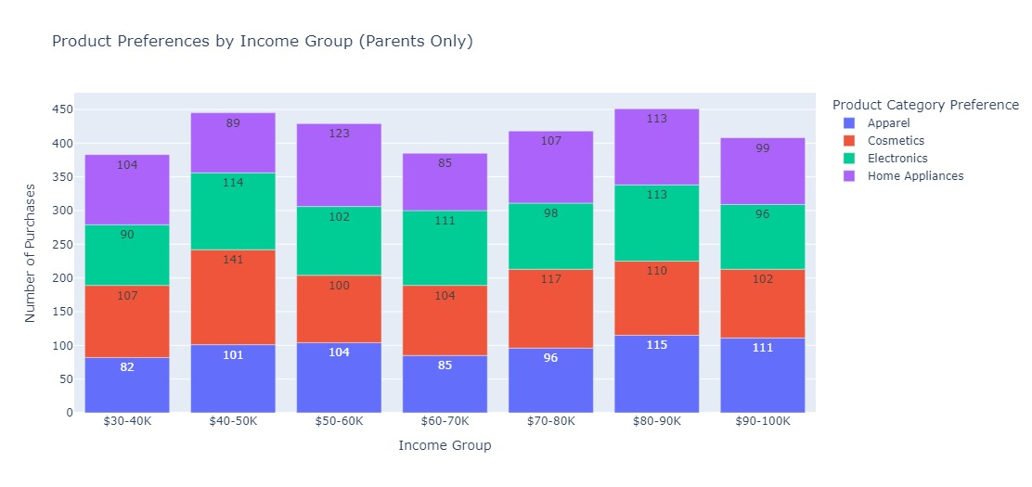
Product Preferences based on different factors

Slide 16
Product Preferences by Number of Children: Parents with one child are most responsive to Cosmetics and Electronics, while parents with two children show equal interest across product categories. Tailoring promotions to the number of children could be an effective strategy, especially in categories like Electronics for parents with one child.
Product Preferences by Income Group (Parents Only): Across all income brackets, Apparel and Home Appliances are the most purchased categories, with higher-income groups ($80-100K) showing a stronger preference for Home Appliances, while mid-income groups ($40-60K) lean more towards Apparel. Electronics and Cosmetics are more evenly distributed but consistently lower in comparison.

Slide 17
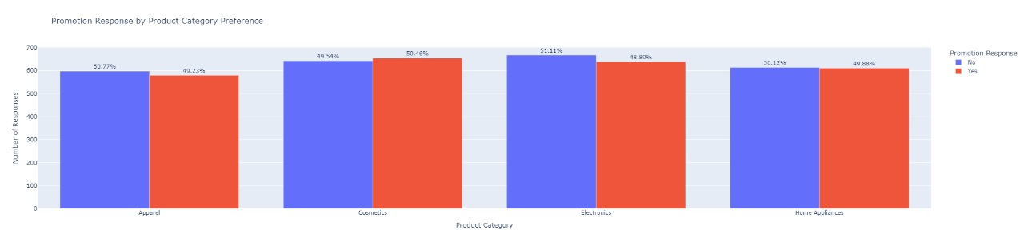
Promotion Responses based on different factors
Consumers in different product categories (Apparel, Cosmetics, Electronics, and Home Appliances) show a nearly equal split between responding to promotions, with a slight preference for promotions in categories like Electronics (51.11%) and Apparel (50.77%). Marketing efforts should focus on promotions for Apparel and Electronics as they seem to drive higher responses.

Slide 18
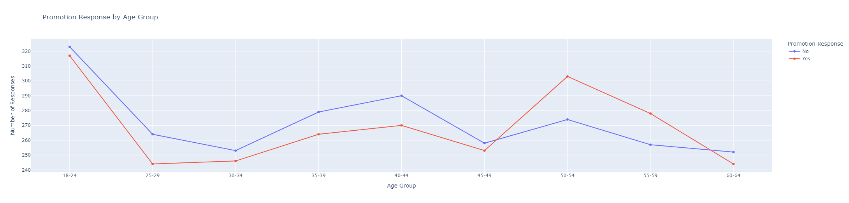
Promotion Response by Age Group

Slide 19
Younger age groups (18-24) show the highest positive response ("Yes") to promotions compared to older groups, with a noticeable decline in promotion sensitivity between ages 25-29.
From 50-54, there is a resurgence of interest in promotions, peaking in this age range before sharply declining as age increases beyond 60.
Ages 55-59 show the largest gap between positive and negative responses, with more individuals responding favorably to promotions.
This suggests that marketing campaigns focusing on promotions may be most effective for young adults and middle-aged consumers (50-54).

Slide 20
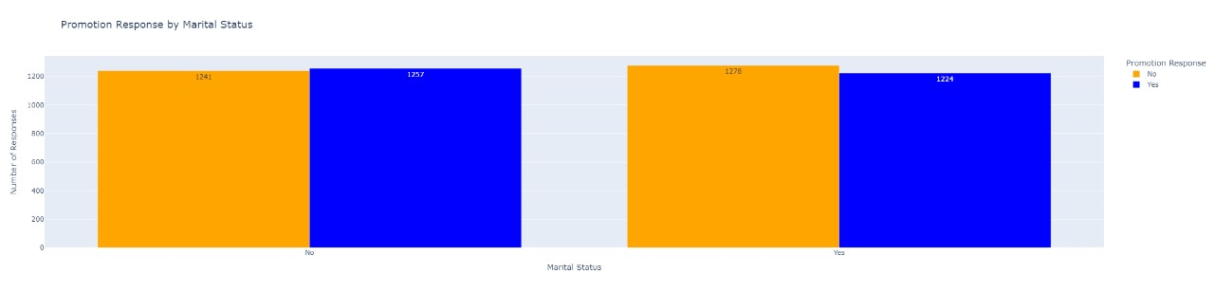
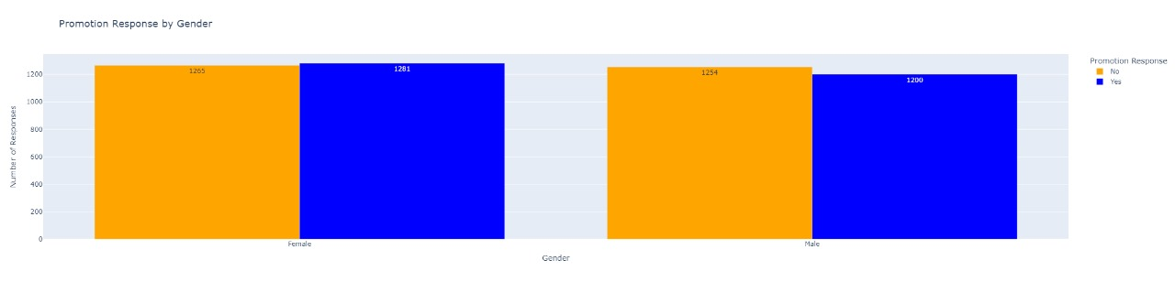
Promotion Responses based on Gender and Marital Status

Slide 21
Promotion Response by Marital Status: Both married and unmarried individuals respond similarly to promotions, though non-married individuals show a slightly higher positive response to promotions.
Promotion Response by Gender: Promotion responses are almost evenly split across genders, with a marginally higher response rate in females compared to males. This indicates that marketing promotions are equally effective for both male and female audiences.

Slide 22
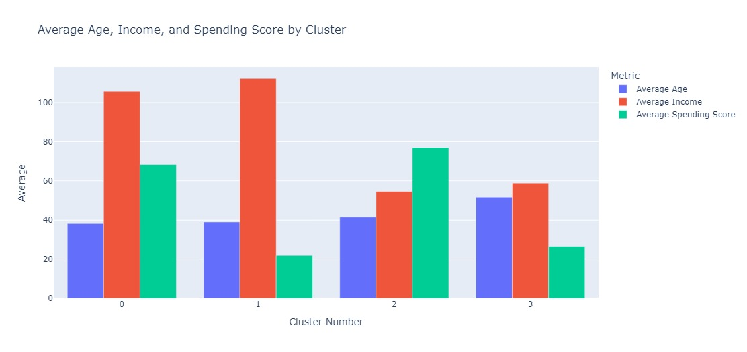
K Means Clustering

Slide 23
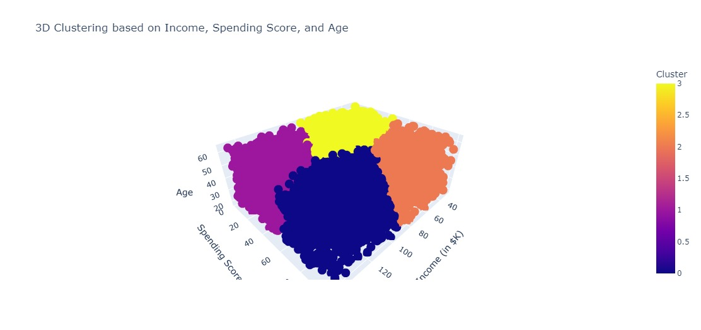
Clustering has helped us understand certain characteristics of the groups. Cluster 0 has high income customers who are also spending a lot, this spending goes down for cluster 2 even though their average income levels go up. Cluster 2 is interesting in how even though their average income levels are moderately low relative to other clusters, their spending is more than their average income levels. The fourth cluster has people who are on average oldest of all the other customers in other clusters, they are spending very low compared to their average earnings.

Slide 24
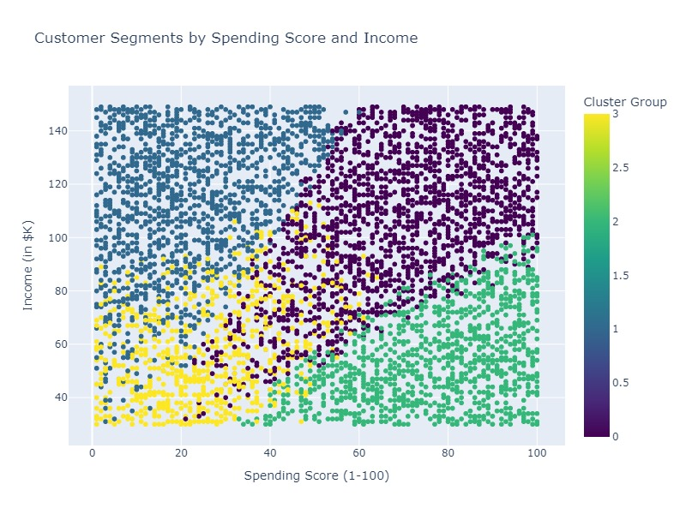
Income Score VS Spending Score

Slide 25
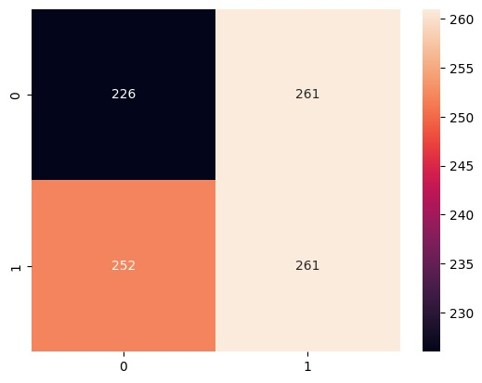
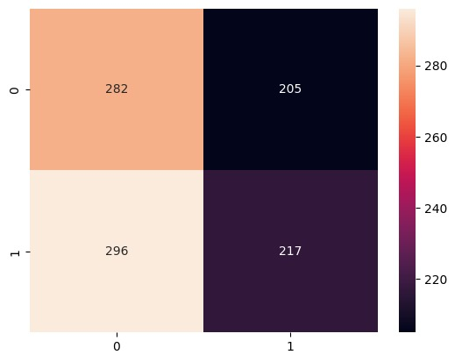
Findings from KNN and Naive Bayes
Confusion Matrix
Accuracy obtained from KNN Model = 0.487 0.499 0.4870.4879%
Accuracy obtained from NAIVE BAYES Model = 0.499

Slide 26
The Naive Bayes and KNN models perform poorly, with accuracy rates of roughly ~50% and ~49% respectively, indicating that the data is not predictive enough to determine product purchases(Buy or Not Buy). This suggests the data lacks distinct features or insights for effective campaign analysis. Though Naive Bayes slightly outperforms KNN, its underfitting makes it unreliable for purchasing insights. The marketing team should try other classification models or prioritize gathering more comprehensive and predictive data, such as transactional and behavioral information, before using these models. Relying on the current data risks inaccurate predictions, wasteful spending, and misdirected efforts.

Slide 27
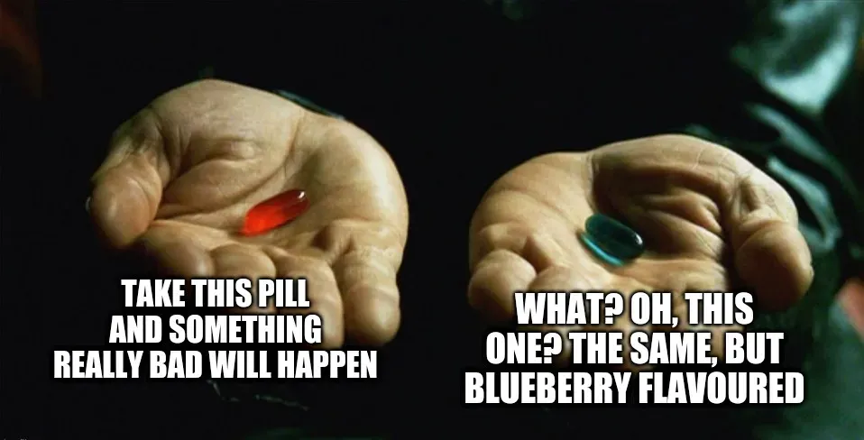
Red Pill or Blue Pill?

Slide 28

We suggest NO pill! Exercise!
Based on the clustering findings, marketing strategies can be tailored to target each consumer group differently, see different exercise for different needs!

Slide 29
Cluster 0: High-Income, High-Spending Customers
Premium Products: Promote luxury items and exclusive services.
Loyalty Programs: Offer high-end rewards for continued spending.
Personalized Marketing: Focus on new products or luxury upgrades.
Experiential Campaigns: Host VIP events or product launches.
Cluster 2: Low-to-Moderate Income, High Spending
Value Products: Highlight quality over price.
Installment Plans: Offer flexible payment options.
Discount Campaigns: Use exclusive discounts or flash sales.
Emotional Campaigns: Appeal to aspirations or self-expression.

Slide 30
Cluster 3: Moderate Income, Moderate Spending
Mid-Range Products: Balance quality and affordability.
Upselling: Bundle products to boost spending.
Incentive Promotions: Offer cashback or points to encourage purchases.
Educational Campaigns: Promote “smart shopping” tips.
Cluster 4: Older Customers with High Income, Low Spending
Retirement Products: Focus on financial security and investment.
Health Campaigns: Promote wellness, insurance, and travel services.
Trust Marketing: Emphasize long-term reliability and support.
Charity Campaigns: Align spending with legacy or charitable cause

Slide 31

What about me???
Cross-Cluster Strategy:
Personalization and Segmentation
Targeted Communication: Customize offers based on spending patterns.
Lifecycle Marketing: Adapt to stages like aspirational spending or wealth management.
By aligning strategies with each cluster characteristics, the agency can enhance customer engagement and boost conversions.

Slide 32
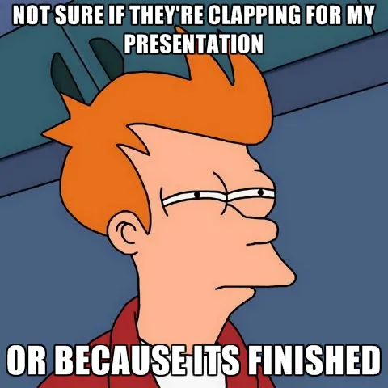

Github: Marketing Campaign Analysis

